Slide 1
U.S. Copyright Law
INFO 4940/5940
Instructor: Mike Priehs
Secondary Liability, Dual-Use Technologies, Technological Protection Measures
April 7, 2025

Slide 2
End of Semester Timeline
This Week:
Monday, April 7 – Secondary Liability Lecture
Wednesday, April 9 – Group Presentations (MGM v. Grokster, Viacom v. YouTube)
Next Week:
Monday, April 14 – Infringement & Remedies Lecture
Wednesday, April 16 – Group Presentations (Salinger v. Colting, U.S. v. Moran, Hachette v. Internet Archive)
Reflection #4 due April 19
Later:
Monday, April 21 – Guest Presentation – Artificial Intelligence & Copyright (attendance will be taken)
Wednesday, April 23 – Group Presentations (Thomson Reuters v. ROSS Intelligence, Whitmill v. Warner Bros, Sedlik v. Von Drachenberg, Whyte Monkee Productions v. Netflix)
Heading Into Finals:
Monday, April 28 – Class is optional; I’ll be available for questions and you can work on your final exams
Wednesday, April 30 – Hold for office hours or makeup date
Reflection #5 due May 3
Monday, April 12 @ 4:30 pm – Final Exam Due

Slide 3

No Judgment Zone!
Has anyone ever…
Received a “copyright strike” on YouTube?
Ever been asked to remove something on social media?
Required to take the university’s copyright law tutorial?
Image Source: https://www.amazon.com/I-Am-Not-Cop-Novel/dp/1416570667

Slide 4
Before Spring Break
Fair Use
Four Factors:
  Purpose and Character of the Use
  Nature of the Copyrighted Work
  Amount and Substantiality of the Portion Used
  Effect on Potential Market or Value of Work

Slide 5
Secondary Liability

Slide 6
Secondary Liability
Copyright infringement liability imposed on someone who does not commit the legal wrong directly, but is found responsible for encouraging, facilitating, or profiting from it.

Slide 7
Why? Is this Justifiable?
Encouraging illegality is widely viewed as immoral (Fairness Theory & Personality Theory)
Gatekeeper Theory: when should we impose liability on parties who, although not the primary beneficiaries of misconduct, might nonetheless be able to prevent it? (Welfare Theory)

Slide 8
Gatekeeping in Copyright Law
Penalties should be imposed on third parties only if:
Otherwise the incidence of copyright infringement would be unacceptably high because direct infringers cannot be controlled by socially acceptable sanctions
The third parties, left to their own devices, would not intervene to curb infringement and indeed might foster it
The third parties we might target are in a position to effectively suppress infringement
The social and economic costs of penalizing the third parties are not unacceptably high

Slide 9
Questions to Ask
When assessing possible secondary liability:
If we penalize this particular third party, will the incidents of direct infringement diminish?
Will the infringers just find another enabler?
What are the social costs of imposing secondary liability in this setting?

Slide 10
Liability of Third Parties in U.S. Law
Doctrines of contributory and vicarious liability
Statutory “safe harbors” that immunize organizations that may otherwise be liable for infringement

Slide 11
Contributory Infringement
One who knowingly induces, causes or materially contributes to copyright infringement by another but who has not committed or participated in the infringing acts him or herself, may be held liable as a contributory infringer if he or she had knowledge, or reason to know, of the infringement

Slide 12
Vicarious Infringement
A person may be held liable for the infringing acts committed by another if he or she had the right and ability to control the infringing activities and had a direct financial interest in such activities. The existence of direct infringement is required to establish a claim of vicarious infringement: however, it is not necessary for the alleged infringer to have intent or knowledge of the infringement.

Slide 13
Contributory vs. Vicarious
To hold defendant liable for contributory infringement:
Someone has engaged in direct infringement
Defendant had actual or constructive knowledge of the infringement
Defendant materially contributed to the infringement
To hold defendant liable for vicarious infringement:
Someone has engaged in direct infringement
Defendant benefited financially from the infringement
Defendant had the right and ability to supervise, or stop, the infringement and failed to do so

Slide 14

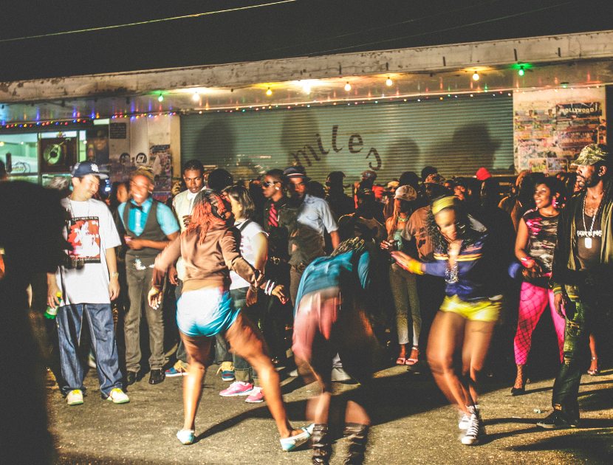
Direct, Contributory & Vicarious: An Illustration
Suppose a musical group performs copyrighted musical compositions in front of a public audience (without permission)
The songs performed were selected by the group’s manager
The owner of the dance hall keeps a portion of the ticket sales
Are there any infringements?

Slide 15
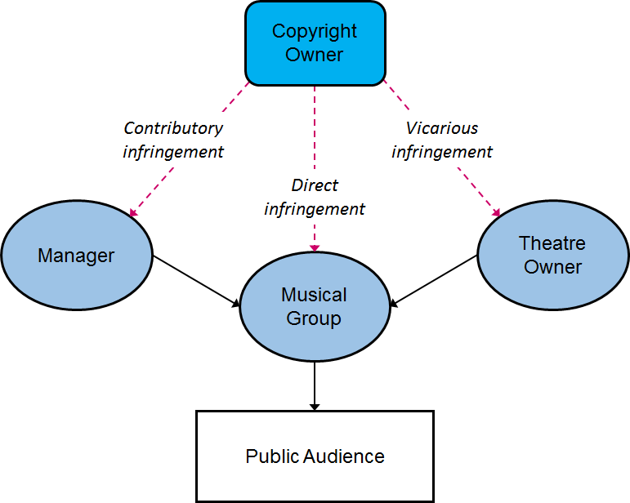

Slide 16
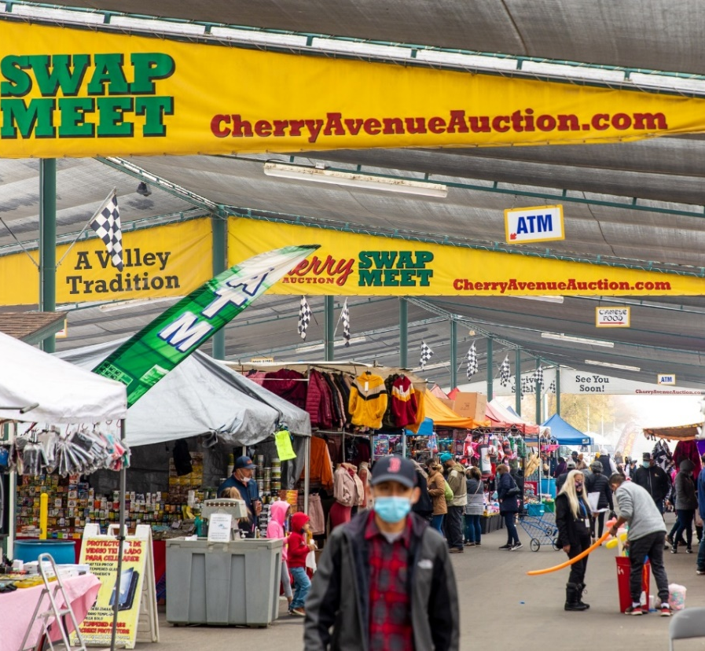
Fonovisa, Inc. v. Cherry Auction, Inc.
Court's Findings
Cherry Auction was liable for contributory and vicarious copyright infringement, as well as contributory trademark infringement
The court reversed the lower court's dismissal of Fonovisa's claims
Impact
Established that operators of venues like swap meets can be held liable for the infringing activities of their vendors if they benefit financially and have the ability to control the infringing conduct
Emphasized the need for venue operators to monitor and prevent copyright infringement on their premises
U.S. Court of Appeals for the Ninth Circuit (76 F.3d 259, 1996)
Cherry Auction operated a swap meet in Fresno, CA where vendors sold bootleg/counterfeit recordings of Fonovisa’s copyrighted music.
In 1991, Sheriff raided the swap meet, seizing over 38,000 unauthorized recordings.
In 1993, Fonovisa observed ongoing sales of bootleg recordings and filed suit.
https://www.facebook.com/CherryAvenueAuction/photos/a.441826015848486/5343413832356322/

Slide 17
Dual-Use Technologies

Slide 18
Dual-Use Technologies
A product or service that customers can sometimes use in ways that violate copyright laws and sometimes use in ways that do not.
Example: Betamax case

Slide 19
Sony v. Universal Studies: “Betamax” Case
Holdings from the case:
The manufacturer of a device that can be used to violate the copyright laws is liable for contributory infringement, if and only if the device is not capable of substantial non-infringing uses
Time-shifting copyrighted programs is a fair use

Slide 20
17 USC Section 512: Statutory Safe Harbors
Basically, ISPs (internet service providers), passive intermediaries who simply carry packets of information from one party to another, are not liable for copyright infringement provided that they do not select the stuff that is sent, or who it sent to, or modify it en route.

Slide 21
17 USC Section 512: Statutory Safe Harbors
OSPs (online service providers) also have some safe harbor
Controversial: OSPs may secure immunity when storing materials sent to them by one person and making that same material accessible to many other people

Slide 22
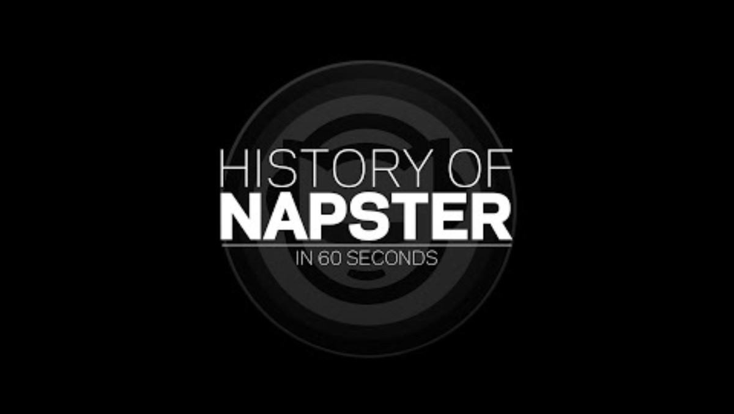
A&M Records, Inc. v. Napster, Inc.

Slide 23
A&M Records, Inc. v. Napster, Inc.
Court's Findings
Napster was aware of and materially contributed to the infringing activities
The service did not qualify for the DMCA safe harbor protections
Preliminary injunction was granted, leading to the shutdown of Napster's service
Impact of Case
Set precedent for holding online service providers liable for secondary liability
Clarified DMCA Safe Harbor limitations
Chilling impact on peer-to-peer file-sharing services
Encouraged record industry to be more aggressive in filing lawsuits
Huge public awareness about copyright infringement

Slide 24
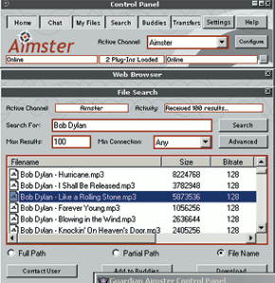
Aimster
Court’s Findings
Aimster’s encryption system and lack of monitoring contributed to copyright infringement
The service did not qualify for safe harbor under 17 U.S.C. § 512(i)
Preliminary injunction was granted, shutting down Aimster’s service
Significance
Clarified contributory and vicarious infringement
“Willful blindness” is not a valid defense
Set a precedent for future cases involving digital file-sharing services and the responsibility of such providers
Full case name: In re Aimster Copyright Litigation. Appeal of: John Deep, Defendant.
Court of Appeals for the Seventh Circuit (334 F3d 643, 2003)
Similar to Napster, though they used encryption to prevent company from knowing the contents of the files.
https://en.wikipedia.org/wiki/Madster#/media/File:Madster-screenshot.png

Slide 25


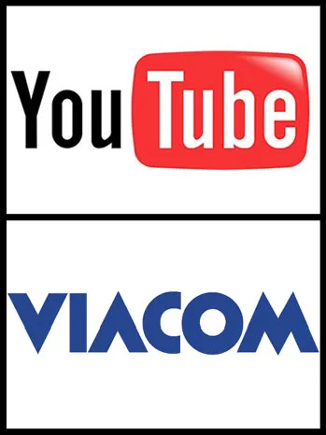
Coming attractions!
MGM v. Grokster
  Can a privately owned software company from the West Indies overcome a challenge from 28 entertainment companies, led by MGM?
vs.
Viacom v. YouTube
  “Brazen” and “Massive”
      Copyright Infringement?
  See what everyone is talking about on Wednesday!
vs.

Slide 26
Technological Protection Measures

Slide 27
WIPO Copyright Treaty (1996), Article 11
“Contracting Parties shall provide adequate legal protection and effective legal remedies against the circumvention of effective technological measures that are used by authors in connection with the exercise of their rights under this Treaty or the Berne Convention and that restrict acts, in respect of their works, which are not authorized by the authors concerned or permitted by law.”

Slide 28
17 USC Section 1201
(a)(1)(A): No person shall circumvent a technological measure that effectively controls access to a work protected under this title
…
(a)(2): No person shall manufacture, import, offer to the public, provide, or otherwise traffic in any technology, product, service, device, component, or part thereof, that—
(A) is primarily designed or produced for the purpose of circumventing a technological measure that effectively controls access to a work protected under this title;
(B) has only limited commercially significant purpose or use other than to circumvent a technological measure that effectively controls access to a work protected under this title; or
(C) is marketed by that person or another acting in concert with that person with that person’s knowledge for use in circumventing a technological measure that effectively controls access to a work protected under this title.

Slide 29
Exceptions
Libraries may circumvent in order to decide whether to buy
Police may circumvent to conduct an investigation
1201(f): Reverse Engineering for Interoperability
1201(g): Encryption research
1201(h): Protecting Minors from Pornography
Special Exemptions created by Copyright Office – applicable only to circumvention of access controls

Slide 30
Questions?
Have a Great Day!

